Slide 1

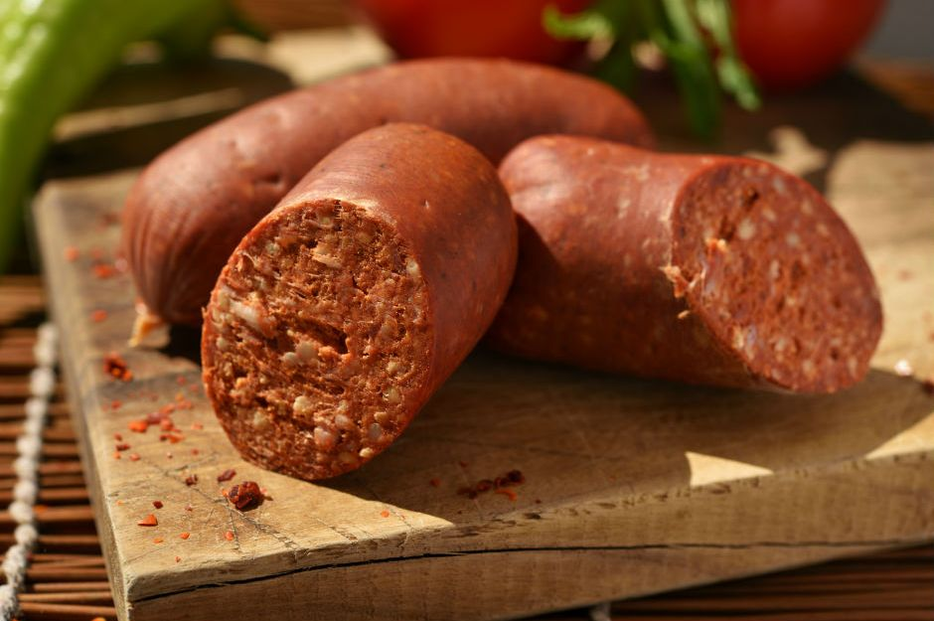

Traditional Turkish Fermented Sucuk: Learning From the Tradition to Inform the Future
Bülent NAZLI
Halime PEHLİVANOĞLU
Muhammed Yusuf ÇAĞLAR

Slide 2

Sucuk
Raw Material
Beef or water buffalo meat,
Additives
salt,
Starter Culture (Only Industrial Products)
Lactic Acid Bacteria
beef fat,
sheep tail fat
sugar,
nitrite, nitrate
various spices
Notes:
Traditional Turkish Fermented Sucuk, which has been known since ancient times is most popular dry-fermented meat product produced in Turkey. Beef, beef fat, sheep tail fat, salt, sugar, nitrite, nitrate and/or nitrite/nitrate, various spices and lactic acid bacteria are used as raw material in the production of sucuk (Kaban & Kaya, 2009). Regarding its nutritional value, Sucuk is an important food product for nutrition and health due to its valuable nutrients and probiotic microorganisms. Usage of starter culture has been increasing in the production of sucuk day by day.

Slide 3

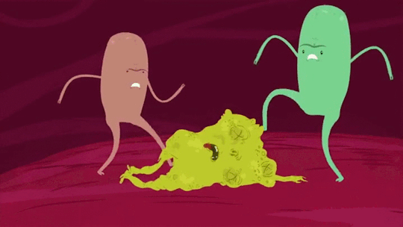

Sucuk
Lactobacilli, Micrococci, Pediococci, some molds and yeasts were found to be dominant in the fermented sucuk ripened under natural conditions (Sağdıç, 2014).
These microorganisms are used as starter cultures and probiotics in fermented products due to their positive contribution to the final product (Rocha & Elias, 2016). In the fermented sucuks, it is reported that Lactobacilli afffect directly in pH reduction and aroma formation and indirectly color formation. Micrococci and Staphylococci play a role in the formation of color and aroma by reducing the nitrate. Therefore, in many countries these microorganisms are used extensively as starter cultures, to control fermentation in sucuks, shorten the ripening period, and obtain standard type product and good quality (Dinçer et. al., 1995).

Slide 4
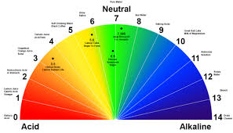
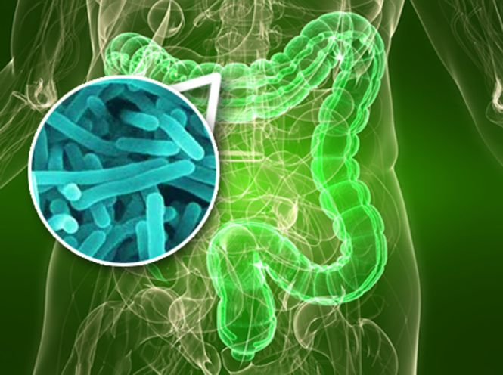
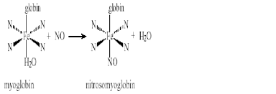

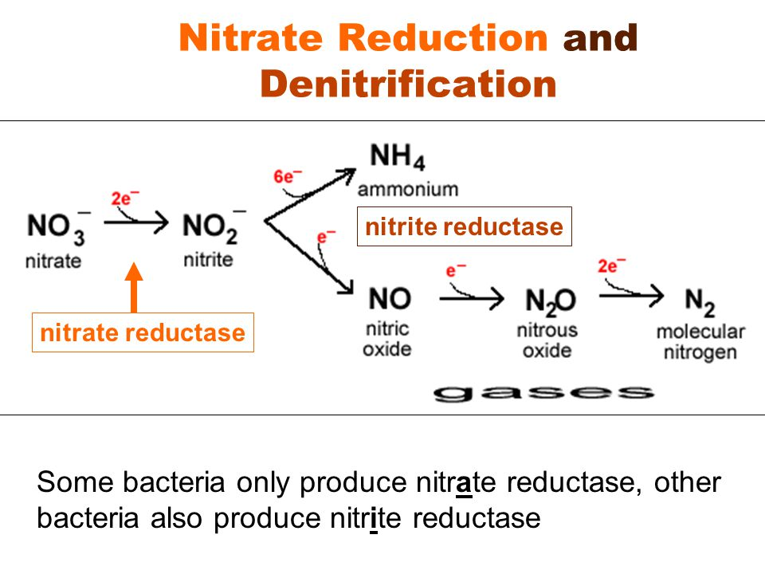
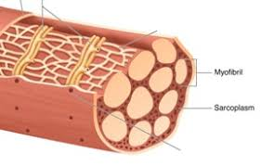
Changes in Turkish Fermented Sucuk during Fermentation
pH decrease
Microflora
Nitrosomyoglobin formation
Reduction of nitrate to nitrite
Gelation of myofibrils and sarcoplasmic proteins
Proteolytic, Lipolytic and Oxidative Changes

Slide 5
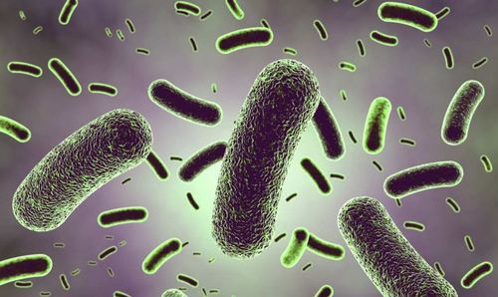
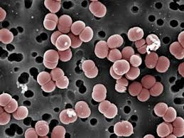
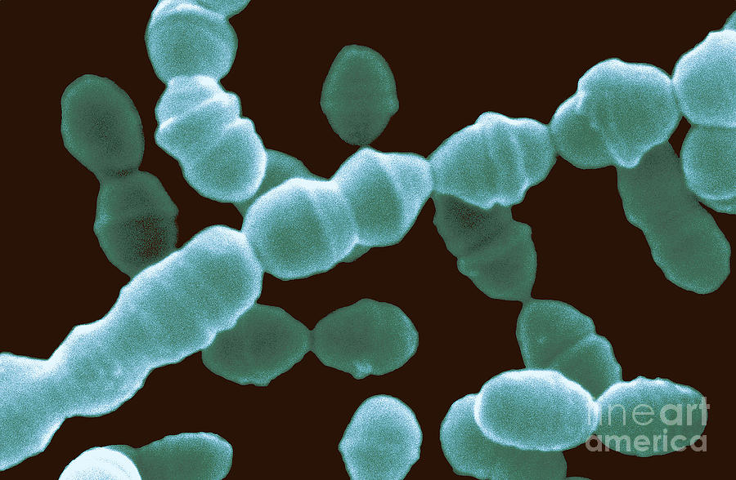
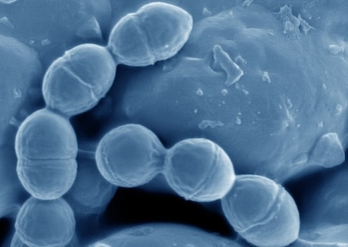
Lactic Acid Bacteria Determined in Fermented Sucuks
01
L. plantarum, L. pentosus L. fermentum, L. brevis, L. sake, L. agilis, L. viridescens, L. carnis, L. casei subs. Rhamnosus
Lactobacillus
02
P. pentosaceus, P. acidilactici
Pediococcus
03
Leuconostoc lactis, Leuc. mesenteroides subsp. mesenteroides, Leuc. mesenteroides subsp. dextranicum
Leuconostoc
04
Lactococcus
Lc. lactis subsp. lactis
Özdemir, 1999; Erdoğrul, 2002; Kaban 2007; Soyer and Ülkü 2008.

Slide 6
Physico-Chemical Properties of Turkish Fermented Sucuk
During the fermentation, the pH value of the fermented sucuk is between 5.6 and 5.8 due to the breakdown of carbohydrates by bacteria, the pH drops to 4.8-5.0. Likewise, in the first days of drying, the humidity 65-70% and it decreases to 40% (Nazlı, 1998; Soyer et al., 2005). According to Turkish Standards Institute, TS-1070, pH value of Turkish sucuk is between 4.7-5.4 and moisture content maximum is 40%, while the fat content can be up to 30% for the first grade, and up to 40% for the second grade. Protein concentration can be up to 20% for the first grade and up to 18% for the second grade (Anonymus, 2012a)

Slide 7
Microbiological Properties of Turkish Fermented Sucuk
Lactic acid bacterias contribute to the formation of desirable sensory properties such as taste, aroma and color of the sucuk with their metabolic products (Drosinos et. al., 2005; Erdoğrul & Ergün, 2005; Talon et. al., 2007; Essid & Hassouna, 2013). The biochemical activities of microorganisms such as Lactobacilli, Staphylococci, Micrococci, molds and yeasts are important in the formation of these fermented sucuk characteristics (Nazlı, 1998). Although probiotic bacterial strains are very limited in the production of processed dairy products and certain fruit juices, they are successfully used in the ripening of meat products. Raw meat products are actually the most suitable source for the development of probiotic microorganisms. In order to take advantage of the probiotic and bioprosthetic properties of lactic acid bacteria in sucuk, heat treatment should not be applied at any stage of production and before consumption, it should be consumed as raw. In addition, the sucuk composition supports the survival of probiotic bacteria in the digestive tract (Ruiz-Mayano et. al., 2011).

Slide 8
Microbiological Properties of Turkish Fermented Sucuk
Meat is an excellent medium for probiotics (Heller, 2001; Rivera-Espinoza & Gallardo-Navarro, 2010; Jaworska et al., 2011). Rouhi et al. (2013) reported that the fermented sucuk-like meat products are a good tool for transporting probiotic cells to the human digestive tract. Because probiotic cells are encapsulated by the sausage structure containing meat and fat. Thanks to this encapsulation, the probiotics become relatively resistant to difficult conditions such as low pH and bile salts in the digestive tract (Rivera-Espinoza & Gallardo-Navarro, 2010; Rouhi et al.,2013)

Slide 9

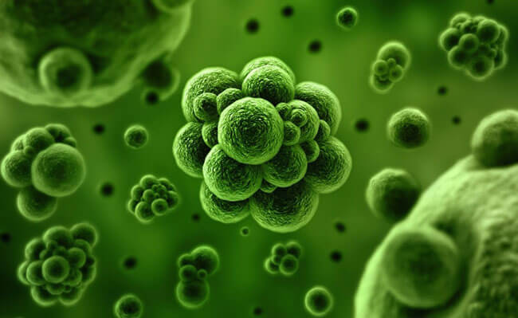
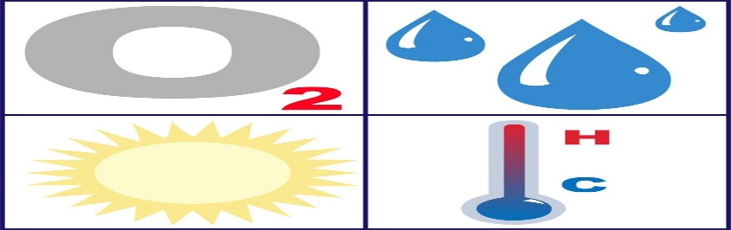
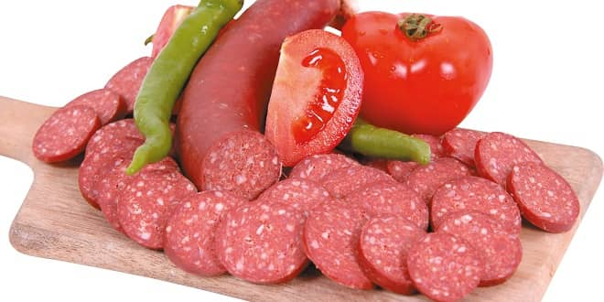
Affecting factors viability and proliferation of probiotics after they are added to fermented meat products
01
The physiological status of the addition of probiotics to the fermented product.
The concentration of probiotic microorganisms
02
03
Probiotics should be resistant to the storage conditions of the product (Temperature, moisture etc).
The chemical composition of the product (pH, water activity, carbon, nitrogen, mineral, oxygen content affect the performance of these bacteria).
04

Slide 10
Sensorial Properties of Turkish Fermented Sucuk
In traditional Turkish fermented sucuks, the sensory properties such as appearance, color, texture, flavor and aroma are shaped depending on the applied technological processes and the microbial activities that occur during fermentation (Lawles & Heyman, 2010; Çiçek et al., 2015).
Spices such as red pepper, black pepper, cumin and garlic, and additives such as salt and sugar which are added to sucuk paste play an important role in the formation of typical color, flavor and aroma (Bingöl, 2014).

Slide 11
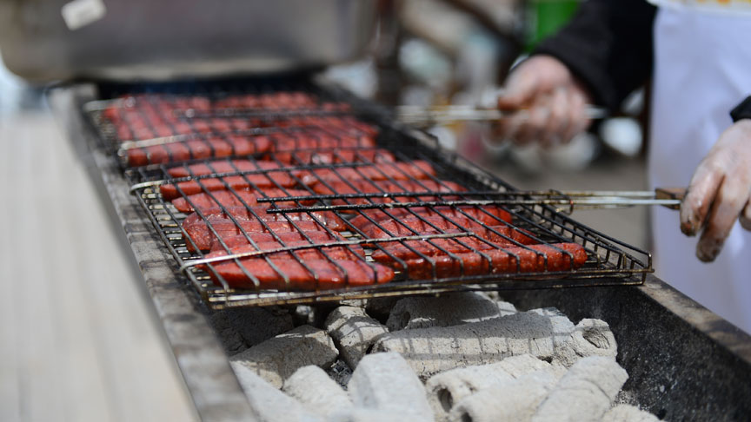
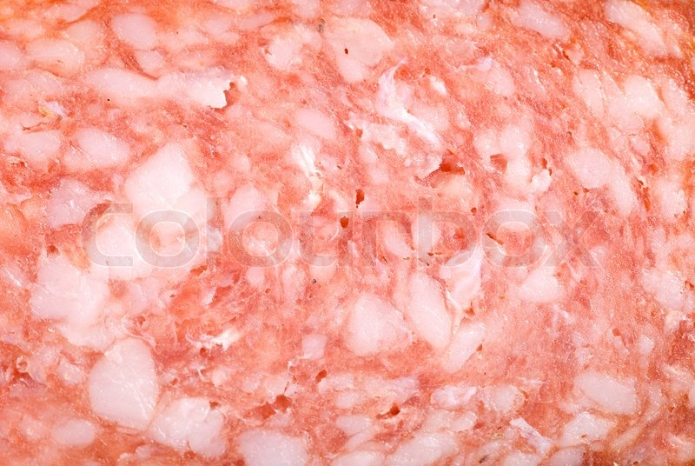
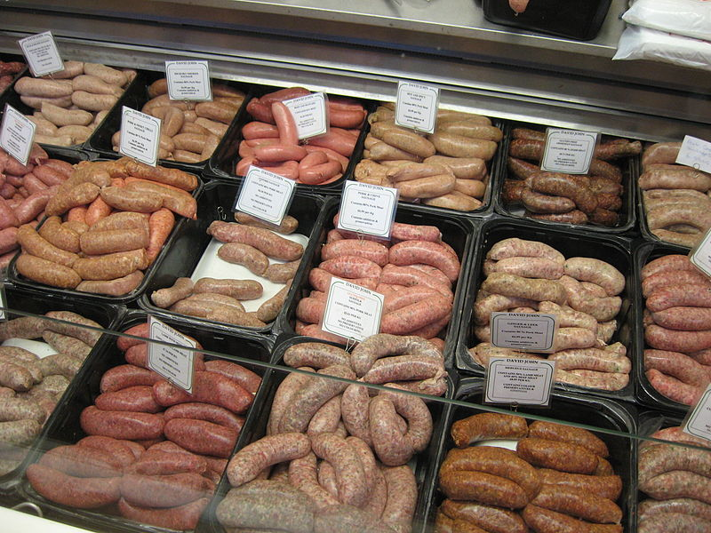
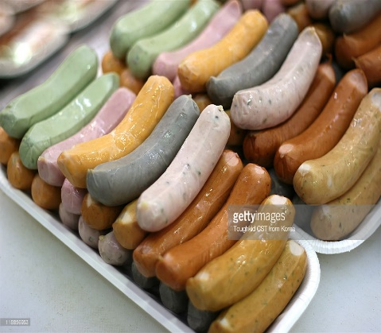
Sensorial properties of Turkish Fermented Sucuk
The sucuk has a normal red meat color, and this color should be the same on the outer surface and along the cross-section of the fermented sucuk. The formation of color in sucuk is due to the reduction of nitrate to nitrites by bacteria and the formation of Nitroso-Myoglobin (NOMb) by combining the formed NO with myoglobin in the meat (Rouhi et al., 2013; Çiçek et al., 2015).
The sucuk paste filled in the intestines should be in homogeneous appearance, there should be no folds, molds, salt stains and bacterial spots on the outer surface of the sucuk casing. Especially fats should not flow out from the intestines. (Nazlı, 1997; Çiçek et al., 2015).
Flavor and Aroma
Texture
The flavour and aroma properties of fermented sucuks due to formation of numerous volatile and non-volatile components during microbial fermentation. Amino acids, peptides, carbonic acid, sugar and organic salts are considered non-volatile aroma substances. Most of these compounds are considered to be the precursors of the volatile aroma substances that will be formed later
towards the end of fermentation (Bilge, 2010; Bingöl et. al. 2014).
Appearance
Color
The texture of fermented sucuk should be medium; not too hard or too soft . For this reason, the meat used in production must be ripe meat and the meat fat mixture must be well-adjusted and well-chilled (Lawless & Heyman, 2010)

Slide 12

Conclusion
Traditional Turkish Fermented Sucuk is a fermented meat product that is produced without heat treatments or starter cultures. Fermented sucuks are dried and ripened under completely natural conditions.
However, in these sucuks, the structure, taste and other characteristics may be different from each other and it is not always possible to produce products with the same characteristics. In addition, due to increasing world population, technological developments and increasing demand, meat products with standardized properties has become mandatory in every season of the year. For this reason, in efforts to standardize the products produced by traditional methods have gained momentum.

Slide 13
Conclusion
Today, many countries in the world continue to utilize natural fermentation without the use of starter cultures by small businesses. In the same way, Traditional Turkish Fermented Sucuk production in Turkey is only carried out locally in some small enterprises. Therefore, these product has become extinct.
It is possible to make this product more useful in terms of food safety and consumer health by optimizing the bioactive functions of probiotic bacteria which are very important for public health in Turkish fermented sucuks.
The sensory properties such as color, texture, taste and aroma that are preferred by consumers develop during ripening with microbial fermentation. Due to having low pH and low water activity values which occurs due to the ripening process, fermented sucuk is a reliable product and has a long shelf life.

Slide 14
Conclusion
In ripe sucuks, Lactobacilli can demonstrate probiotic properties and dominate to the microflora. Therefore fermented sucuks should be considered as a probiotic meat product. In Turkey, there are very modern and high capacity facilities which were built in accordance with global standards. In these facilities, it is possible to produce sucuks in a shorter time by using starter cultures unique to Turkish fermented sucuk, by controlled fermentation and drying.
Therefore, it is necessary that the Traditional Turkish Fermented Sucuk characteristics should not be lost, the production of this product be encouraged, developed and popularized. Finally, geographical marking of sucuk needs to be completed rendering fermented sucuk a national product.

Slide 15
References
Soyer A., Ülkü D., 2008. Effect of processing methods and starter culture (Staphylococcus xylosus and Pediococcus pentosaceus) on proteolytic changes in Turkish sausages (sucuk) during ripening and storage. Meat Science, 80, 345–354
Özdemir H. 1999. Türk fermente sucuğunun florasındaki dominant laktobasil türlerinin sucuğun organoleptik nitelikleri ile ilişkisi. Ankara Üni. Vet Fak Derg, 46, 189-198
Kaban G., 2007. Geleneksel olarak üretilen sucuklardan laktik asit bakterileri ile katalaz pozitif kokların izolasyonu-identifikasyonu, üretimde kullanılabilme imkanları ve uçucu bileşikler üzerine etkileri. Atatürk Üniversitesi Fen Bilimleri Enstitüsü Gıda Mühendisliği Anabilim Dalı Doktora Tezi, 116 S, Erzurum.
Erdoğrul Ö. T., 2002. Fermente sucuklardan izole edilen Pediococcus pentosaceus suşlarının bazı metabolik ve antimikrobiyal aktiviteleri üzerine çalışmalar. İstanbul Üni. Vet. Fak. Derg., 28 (1) 249-254

Slide 16
References
Rocha MJ, Elias MN. Quality Improvement of Traditional Dry Fermented Sausages Based on Innovative Technological Strategies. BAOJ Nutrition. 2016; 2: 1-4
Sagdic, O. (2014). Biodiversity of yeast mycobiota in “sucuk,” a traditional Turkish fermented dry sausage: phenotypic and genotypic identification, functional and technological properties. Journal of food science, 79(11).
Dincer B, Ozdemir H, Mutluer B, Yagli O, Erol I, Akgun S. Isolation, identifi cation and production of starter culture bacteria specific to Turkish fermented sausage. Journal of Ankara Univ Vet Fac. 1995; 42: 285-293.
Dalmıs U, Soyer A. Effect of processing methods and starter culture (Staphylococcus xylosus and Pediococcus pentosaceus) on proteolytic changes in Turkish sausages (sucuk) during ripening and storage. Meat Sci. 2008; 80: 345-354.
Nazlı B. Researches on the ripening of Turkish Fermented Sausage using a local starter culture combination. Tr. J. of Veterinary and Animal Sciences. 1998; 22: 393-397.

Slide 17
References
Soyer A, Ertaş AH, Uzumcuoglu U. Effect of processing conditions on the quality of naturally fermented Turkish sausages (sucuks). Meat Science. 2005; 69: 135-141.
Anonim (2012a) Turkish Sausage TS1070. Turkish Standards Institute, Ministries, Ankara.
Ruiz-Moyano, S., Martin, A., Benito, M. J., Aranda., E., Casquete, R. Cordoba, M., G. Implantation Ability of the Potential Probiotic Strain, Lactobacillus reuteri PL519, in “Salchichon” a Traditional Iberian Dry Fermented Sausage. Journal of Food Science. Vol. 76, Nr. 5, 2011.
Heller KJ (2001). Probiotic bacteria in fermented foods: Product Characteristics and starter organisms. Am. Soc. Clin. Nutr. 73: 3745-3792.

Slide 18
References
Rivera-Espinoza, Y.,Gallardo-Navarro, Y. (2010) Non-dairy probiotic products Food Microbiology 27; 1–11.
Rouhı, M., Sohrabvandı, S., Mortazavıan, A. M. Probiotic Fermented Sausage: Viability of Probiotic Microorganisms and Sensory Characteristics. Critical Reviews in Food Science and Nutrition, 53:331–348 (2013).
Cicek U, Kolsarici N, Candogan K. The sensory properties of fermented Turkey sausages: effects of processing methodologies and starter culture. Journal of Food Processing and Preservation. 2015; 39: 663-670.
Lawless HT, Heymann H. Sensory evaluation of food: Principles and Practices. (2nd edn), Springer Science & Business Media, Newyork, USA. 2010.

Slide 19
References
Jaworska, D., Neffe, K., Kolozyn-Krajewska, D., Dolatowski, Z. 2011. Survival during storage and sensory effect of potential probiotic lactic acid bacteria Lactobacillus acidophilus Bauer and Lactobacillus casei Bif3’/IV in dry fermented pork loins. Int. Journal of Food Sci. And Tech. J. 1365- 2621.2011.02772.x
Rivera-Espinoza, Y.,Gallardo-Navarro, Y. (2010) Non-dairy probiotic products Food Microbiology 27; 1–11.
Rouhı, M., Sohrabvandı, S., Mortazavıan, A. M. Probiotic Fermented Sausage: Viability of Probiotic Microorganisms and Sensory Characteristics. Critical Reviews in Food Science and Nutrition, 53:331–348 (2013).

Slide 20
References
Cicek U, Kolsarici N, Candogan K. The sensory properties of fermented Turkey sausages: effects of processing methodologies and starter culture. Journal of Food Processing and Preservation. 2015; 39: 663-670.
Lawless HT, Heymann H. Sensory evaluation of food: Principles and Practices. (2nd edn), Springer Science & Business Media, Newyork, USA. 2010.
Bingol EB, Ciftcioglu G, Eker FY, Yardibi H, Yesil O, et al. Effect of starter cultures combinations on lipolytic activity and ripening of dry fermented sausages. Italian Journal of Animal Science. 2014; 13: 776-781.
Bilge G. The Infl uence of Microbiological and Biochemical Varieties of Production Temperature and Starter Culture During Sucuk Production. Graduate Thesis, Ankara University, Institute of Science, Department of Food Engineering, Ankara. 2010.

Slide 21
References
Nazli B, Senol A. Researches on Microbiological Decomposition of Turkish Fermented Sausages. Turk J Vet Anim Sci. 1997; 21: 487-492.
Talon R, Leroy S, Lebert I. Microbial ecosystems of traditional fermented meat products: The importance of indigenous starters. Meat Sci. 2007; 77: 55-62.
Degirmencioglu MA, Gokgozoglu İ, Tavsanlı H. A Research on Determination of Changes in Properties of Sausages Ripened by Classical Type and Heat Treatment. Turkey 9th Food Congress. Balikesir Univ Susurluk Vocational High School, Susurluk, Balikesir. 2006; 24-26.
Essid I, Hassouna H. Effect of inoculation of selected Staphylococcus xylosus and Lactobacillus plantarum strains on biochemical, microbiological and textural characteristics of a Tunisian dry fermented sausage. Food Control. 2013; 32: 707-714.

Slide 22
Thank you for your patience and attention…

